Slide 1
≪旧制度≫ Application for Yamaguchi University Entrance Fee Waiver and Deferment of Collection and Tuition Fee Waiver for the first semester of the 2025 academic year （graduate students entering April 1 2025）
Admission Fee Waiver and Deferment System 2
Tuition fee exemption 4
Schedule for FY2025 6
Submission of documents
（１）Propose a mandatory category 8
（２）Documents related to income 9
（３）Documents related to deductions 10
（４）Other documents 10
【Form】
Proof of (expected)salary payment（給与等支給（見込）証明書） 12
Proof regarding retirement（退職に関する証明書） 14
Certificate of enrollment and certificate of tuition fee exemption status
（在学証明書及び授業料免除状況証明書） 16
Written statement of long-term recuperation（長期療養申立書） 18
Application for admission fee exemption/Application for deferred collection of admission
fees(Japanese version)（入学料免除・入学料徴収猶予願・日本語版） 20
Application for admission fee exemption/Application for deferred collection of admission
fees(English version) （入学料免除・入学料徴収猶予願・英語版） 21
Application form for entrance fee waiver and deferment（入学料免除・徴収猶予申請票） 22
Students in Yoshida campus：students support section,student affairs division(Yoshida campus)
（Tel）083-933-5611
（E-mail）ga113@yamaguchi-u.ac.jp

Slide 2
Admission Fee Waiver and Deferment System
１．Those who meet any of the following conditions are eligible to apply・・・Graduate students
（１） Students who have difficulty in paying the tuition fee by the deadline due to financial reasons and who are recognized as meeting certain academic criteria.
（２）【One year prior to enrollment】Students those who have difficulty in paying tuition fees due to the following reasons.
・The person responsible for paying school expenses has died
・The student or the person responsible for paying school expenses has suffered damage from a
disaster, such as a storm or flood in Japan.
２．Exemption Amounts
・Entrance fee waiver amount・・・Full or half of the entrance fee
・Deferment of Entrance Fee・・・Full of the entrance fee
３．About Application
Please note that there are 🔷two levels of acceptance.
（１）🔷During the enrollment process
Submission of documents ： 「Application for admission fee exemption/Application for deferred
collection of admission fees」
（２）Preparation of required documents
Documents required for application for entrance fee waiver and deferment of entrance fee are
the same as those for application for tuition fee waiver.
（ⅰ） When apply for entrance fee waiver only, or, apply for both tuition fee waiver and entrance fee waiver
Please see page 8～10 of this handbook, and prepare the necessary documents.
It is not necessary to prepare two copies, one for tuition fee waiver and the other for admission
fee waiver, and prepare 「Application form for entrance fee waiver and deferment」,Envelope（長
形３号）（460 yen stamp is required）
When the submission period arrives, follow the procedure.(see 4 page 「２．（１）」)
（ⅱ） When apply for tuition fee waiver only
When the submission period arrives, follow the procedure.(see 4 page 「２．（１）」)

Slide 3
（３）🔷After Admission
（４）Notification of Admission fee waiver and Deferment Results
July 2025 (planed)
Exemption results will be sent by return envelope.
Those who are exempted or denied half the amount as a result of their application must pay
the relevant entrance fee by the deadline specified in the notification of the application result.
Submission period | April 14(Mon) , 2025 to April 18(Fri), 2025 ※Office Hours : 9:00 am～12：00pm、13:00pm～17：00pm
Submission of documents | Please see （２）
Submission counter | Students in Yoshida campus：students support section,student affairs division(Yoshida campus) tel:083-933-5611 Students in kogushi campus：education/students support section,educational affairs division,faculty of medicine and health scienses(Kogushi campus) tel:0836-22-2099 Students in tokiwa campus：students section,educational affairs division,faculty of engineering (Tokiwa campus) tel:0836-85-9011

Slide 4
Tuition fee exemption
１．Those who meet any of the following conditions are eligible to apply・・・Graduate students
（１） Students who have difficulty in paying the tuition fee by the deadline due to financial reasons and who are recognized as meeting certain academic criteria.
（２） 【One year prior to enrollment】Students those who have difficulty in paying tuition fees due to the following reasons.
・The person responsible for paying school expenses has died
・The student or the person responsible for paying school expenses has suffered damage from a
disaster, such as a storm or flood in Japan.
２．About Application
（１）How to apply
①Prepare necessary documents（See page 8 onward）
②After logging in, fill in the required information, print out the form「Application for
Tuition Fee Exemption 」「Family situation report」「Hearing report on the situation of the
applicant」
https://exemption.jimu.yamaguchi-u.ac.jp/exemption-request-system-for-student/login.jsf
③Submit to the above location
・Required documents prepared in ①
・「Application for Tuition Fee Exemption」
・「Family situation report」
・「Hearing report on the situation of the applicant」
※Submission by mail or by anyone other than the applicant himself/herself will not be
accepted. The applicant must submit the application “in person” only.
（２）Application result notification
Early August 2025
Submission period | April 14(Mon) , 2025 to April 18(Fri), 2025 ※Office Hours : 9:00 am～12：00pm、13:00pm～17：00pm
Submission of documents | See page 8 onward
Submission counter | Students in Yoshida campus：students support section,student affairs division(Yoshida campus) tel:083-933-5611 Students in kogushi campus：education/students support section,educational affairs division,faculty of medicine and health scienses(Kogushi campus) tel:0836-22-2099 Students in tokiwa campus：students section,educational affairs division,faculty of engineering (Tokiwa campus) tel:0836-85-9011

Slide 5
３．In case of missing documents
After the application documents are submitted, if there are any missing documents, the University will ask the applicant to submit them by the deadline specified by the University.If you are contacted by phone or email to the applicant's official Yamaguchi University email address, please respond as soon as possible.
If the missing documents are not submitted by the deadline specified by the University, a written reminder will be sent. If the documents are not submitted by the deadline specified in the reminder letter, the application will be invalidated.Please keep this in mind.
４．Application Results and Tuition Payment
You can download the decision notice of the application result uploaded on the tuition fee waiver system. The date when the decision notice can be downloaded will be announced via the official Yamaguchi University webmail. If payment of tuition fees is required according to the result of the application, please confirm the details of the payment method, etc. in the result notification.If payment is not made, you will be expelled from Yamaguchi University. Please note that failure to make payment may result in expulsion from the program.
５．Precautions
✔Depending on the circumstances of the applicant and his/her family, the applicant may be asked to submit documents that are not listed as documents to be submitted. The applicant and his/her family may be asked to submit documents that are not listed as documents to be submitted.
✔If the information in the application documents is not true, the granting of the exemption may be revoked even after notification of the results of the application.
✔In the following cases, contact the Student Support Section, Student Support Division, as soon as possible.
（If the applicant takes a leave of absence or withdraws from school after application, or if there is a change in the applicant‘s contact information）
✔After submitting the application documents, please notify the Student Services Section of the Student Support Division as soon as possible if there is a change in your family's financial situation due to a change in employment, or if there is a change in your family's financial situation due to a family member living in the same household becoming independent.
✔If you are unable to apply in person during the application period due to study abroad, etc., please contact the Student Services Section before you go to study abroad.
✔Once submitted, documents cannot be returned or viewed.

Slide 6
Schedule for FY2025
Students enrolled in April | Tuition fee exemption | Admission Fee Waiver
① before entering school
During the enrollment process |  | Please submit the「Application for admission fee exemption/Application for deferred collection of admission fees」
② after entering school（First semester）
April 14 ～ April 18 | （ⅰ）When apply for entrance fee waiver only, or, apply for both tuition fee waiver and entrance fee waiver Please submit the following documents. ・「necessary documents 」 ・「Application for Tuition Fee Exemption 」 ・「Family situation report」 ・「Hearing report on the situation of the applicant」 ・「Application form for entrance fee waiver and deferment」 ・Envelope（長形３号）（460 yen stamp is required） Any missing documents will be communicated via university webmail. （ⅱ）When apply for tuition fee waiver only Please submit the following documents. ・「necessary documents 」 ・「Application for Tuition Fee Exemption 」 ・「Family situation report」 ・「Hearing report on the situation of the applicant」 Any missing documents will be communicated via university webmail.
Mid July |  | We will send notification of the results of the entrance fee waiver. Students who are not approved or who are approved for half of the entrance fee must pay the designated entrance fee by the due date.
Early Aug | Students who are not fully exempted from the tuition fee must pay the designated tuition fee by the end of August after confirming the result of the exemption through the Tuition Fee Exemption Student System or webmail.
② after entering school（second semester）
August | Please submit the following documents. ・「necessary documents 」 ・「Application for Tuition Fee Exemption 」 ・「Family situation report」 ・「Hearing report on the situation of the applicant」 Any missing documents will be communicated via university webmail.
January of the following year | Students who are not fully exempted from the tuition fee must pay the designated tuition fee by the end of January after confirming the result of the exemption through the Tuition Fee Exemption Student System or webmail.
It is not necessary to prepare two copies, one for tuition fee waiver and the other for admission fee waiver.
Students enrolled in Oct | Tuition fee exemption | Admission Fee Waiver
① before entering school
During the enrollment process |  | Please submit the「Application for admission fee exemption/Application for deferred collection of admission fees」
② after entering school（second semester）
Early October | （ⅰ）When apply for entrance fee waiver only, or, apply for both tuition fee waiver and entrance fee waiver Please submit the following documents. ・「necessary documents 」 ・「Application for Tuition Fee Exemption 」 ・「Family situation report」 ・「Hearing report on the situation of the applicant」 ・「Application form for entrance fee waiver and deferment」 ・Envelope（長形３号）（460 yen stamp is required） Any missing documents will be communicated via university webmail. （ⅱ）When apply for tuition fee waiver only Please submit the following documents. ・「necessary documents 」 ・「Application for Tuition Fee Exemption 」 ・「Family situation report」 ・「Hearing report on the situation of the applicant」 Any missing documents will be communicated via university webmail.
Mid-December |  | We will send notification of the results of the entrance fee waiver. Students who are not approved or who are approved for half of the entrance fee must pay the designated entrance fee by the due date.
January of the following year | Students who are not fully exempted from the tuition fee must pay the designated tuition fee by the end of January after confirming the result of the exemption through the Tuition Fee Exemption Student System or webmail.
It is not necessary to prepare two copies, one for tuition fee waiver and the other for admission fee waiver.

Slide 7
The following paragraphs and thereafter are a list of required documents.

Slide 8
６-（１）Propose a mandatory category･･･ submit documents marked with an asterisk (★) in the appropriate category
・Documents must be submitted for all family members of the same household.
・If you are an international student receiving remittances, please refer to (4). Some documents need to be submitted separately.
・In cases you do not have all three items circled in blue, your application will not be accepted.
classification |  |  | necessary documents | matters that require attention
General Students | privately-financed foreign student | person who earns his living by working alone
★ | ★ | ★ | Application for Tuition Fee Exemption(original) | After entering the information into the system, print it out.
★ | ★ | ★ | Family situation report(original) | After entering the information into the system, print it out.
★ | ★ | ★ | income and taxation certificate（2024）(original) | Required for all family members of the same household. However, foreign students not residing in Japan as of January 1, 2023 are not required to submit this form.
 | ★ | ★ | Hearing Report on the Situation of the Applicant(original) | After entering the information into the system, print it out.
 | ★ |  | Photocopy of Residence Card (both sides)(copy) | All members of the same Lifecare family are required to share.
 | ★ | ★ | Photocopy of Health Insurance Card(copy) | All members of the same Lifecare family are required to share.
 |  | ★ | Documents to show that the applicant is no longer dependent under the Income Tax Law

Slide 9
６-（２）Documents related to income
.・Documents must be submitted for all family members of the same household.
classification | necessary documents | matters that require attention | Issuing Institution, etc.
Salary Income (incl. part-time jobs) | Withholding Tax Certificate for the year 2024 (copy) | ・If newly employed after January 2, 2024, submit「 proof of (expected)salary payment」 ・If not available, copies of payslips for the most recent three(3) month(copy) ・TA and RA are also included as part-timers. | Place of employment
Recipients of employment insurance / unemployment benefits | employment insurance qualified recipient’s identificationcard(front/back)(copy) | Please submit the basic daily fee and the number of remaining days. | Hello work
Pension and Benefit Recipients | withholding record for pensions for 2024 (copy) |  | Japan Pension Service, etc.
Disability pension recipients and survivors' pension recipients | Pension payment (remittance) notice (copy) or pension amount revision notice (copy) |  | Japan Pension Service, etc.
Child Allowance Recipients | a notification regarding child allowance showing the amount(copy) |  | municipal office
Child Support Allowance recipients | ・child rearing allowance certificate(copy) ・notification regarding decision with regard to child rearing allowance amount(copy) ・notification regarding revision with regard to child rearing allowance amount(copy) |  | municipal office
Special Child Support Allowance recipients | ・special child rearing allowance certificate(copy) ・notification regarding decision with regard to special child rearing allowance amount(copy) ・notification regarding revision with regard to special child rearing allowance amount(copy) |  | municipal office
Recipients of sickness and injury benefits | notification regarding decision with regard to sickness and injury allowance(copy) |  | insurer
Life Protection Recipients | Latest welfare decision (change) notification (copy) |  | municipal office
Income other than from salary (Income from business, agriculture, real estate, interest and dividends, and miscellaneous income) | 【If you are filing a tax return】 ・the tax return form(2024)1,2,3(copy) 【If you are filing a citizen's or prefectural tax return】 ・The tax return for the fiscal year of 2025 and the municipal tax and the prefectural tax(copy) | ・If you changed your business or started your business after January 2024, please submit “documents showing income and necessary expenses for the last 3 months (any form)” in addition to the documents listed on the left. | tax office municipal office
If you have resigned from your job | 「proof regarding retirement」(original) |  | Former Employer
学資負担者等が死亡した場合 | ・死亡診断書（写）等、死亡が確認できる書類（原本） ・退職に関する証明書（原本） ・生命保険金等の支給証明書（写） ・遺族年金の年金証書（写）、年金支払（振込）通知書（写） 又は年金改定通知書（写） |  | medical institution Former Employer nsurance companies, etc.
In the event of the death of the person who bears the burden of school expenses, etc.(on or after April 1,2024) | ・A copy of a death certificate or other document that confirms death ・「proof regarding retirement」 (original) ・a certificate of payment of life insurance benefits (copy) ・a certificate of survivor's pension(copy) ・a notice of pension payment (transfer) , or a notice of pension revision(copy)

Slide 10
６-（３）Documents related to deductions
・If you wish to claim the following deductions, please submit the appropriate documentation.
・If the documents are not submitted by the deadline specified by the University, the deduction will not be applied.
classification | necessary documents | matters that require attention | Issuing Institution, etc.
If the applicant's siblings are enrolled in a university (junior college), college of technology, or special training college (vocational or advanced course) | 「certificate of enrollment and certificate of tuition fee exemption status」(original) |  | being in school
If you have a physical or mental disability | disability certificate |  | municipal office
If the patient is in long-term care for more than 6 months | ・「written statement of long-term recuperation」(original) ・Medical certificate from a doctor confirming that the applicant has been under medical treatment for more than 6 months and is still under (original) ・Receipts for the most recent year(copy) ・If you received compensation for high-cost medical care, etc., an indication of the amount(copy) |  | medical institution insurance association
When the applicant or the person responsible for the school expenses has suffered a disaster in Japan On or after April 1, 2024 | ・disaster victim certificate(original) ・valuation certificate(original) |  | municipal office
６-（４）Other documents
classification | necessary documents | matters that require attention
2024 Scholarship Recipients | Scholarship acceptance letter(copy) | Please submit proof of the amount received.
If you are an international student and have money to send home | Documents that prove the amount of money sent for support (copy)
International students receiving a scholarship from their home country | acceptance letter for scholarship in your own country(copy)

Slide 11
The next and following pages are a collection of forms.
Please print and use the form without “sample” if necessary.

Slide 12
If any of the following apply to you, please submit ✔Newly employed or changed jobs on or after January 2, 2024, who are in a regular employee or other employment status that pays bonuses. ✔Those who do not have a paycheck because their salary is handed over in cash (mainly part-timers) ✔Those who do not have a certificate of withholding tax for 2024 ✔Those who have experienced a significant decrease in salary, or those who have not retired but do not have pay stubs because they are no longer working.
Business establishment entry field

Slide 13
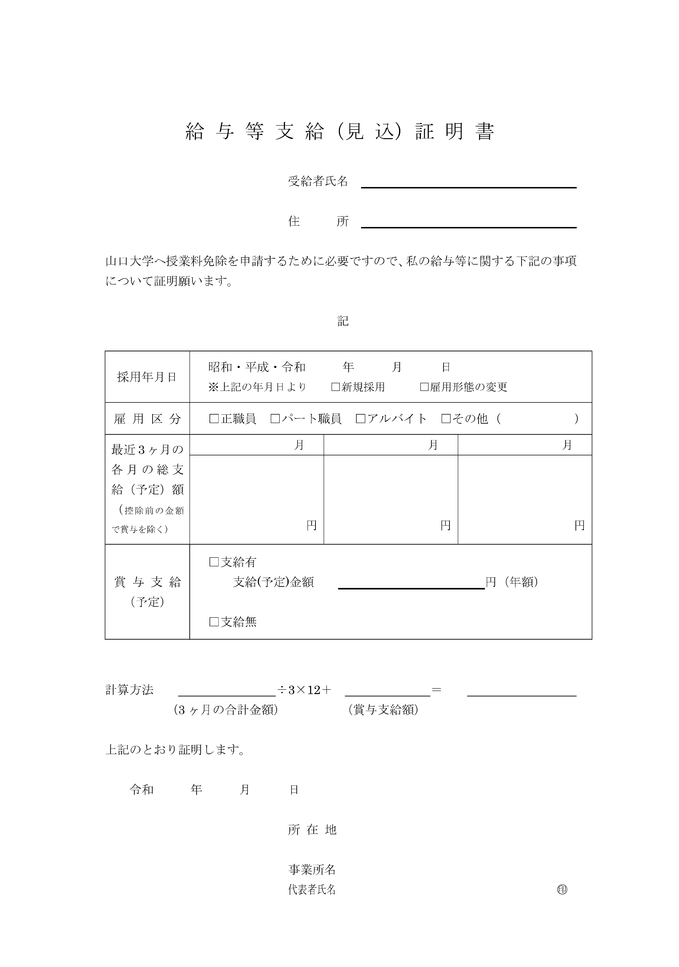

Slide 14
If you were a full-time employee at the time of retirement, submit this form regardless of whether or not you had any extraordinary income (retirement allowance, etc.). ※Not required for part-time employees. ✔For students admitted in 2025 ・If you retired on or after April 1, 2024 ・If you received extraordinary income (retirement allowance, etc.) on or after April 1, 2024
Business establishment entry field

Slide 16
If the applicant‘s siblings are enrolled in a university (junior college), college of technology, or special training school (vocational or advanced course), they are eligible for the deduction. ✔「貴学在学者」・・・ Provide information about your siblings ✔「山口大学在学者」・・・ Provide information about The applicant himself/herself
School entry field
Enter a date after April 1, 2025.

Slide 17
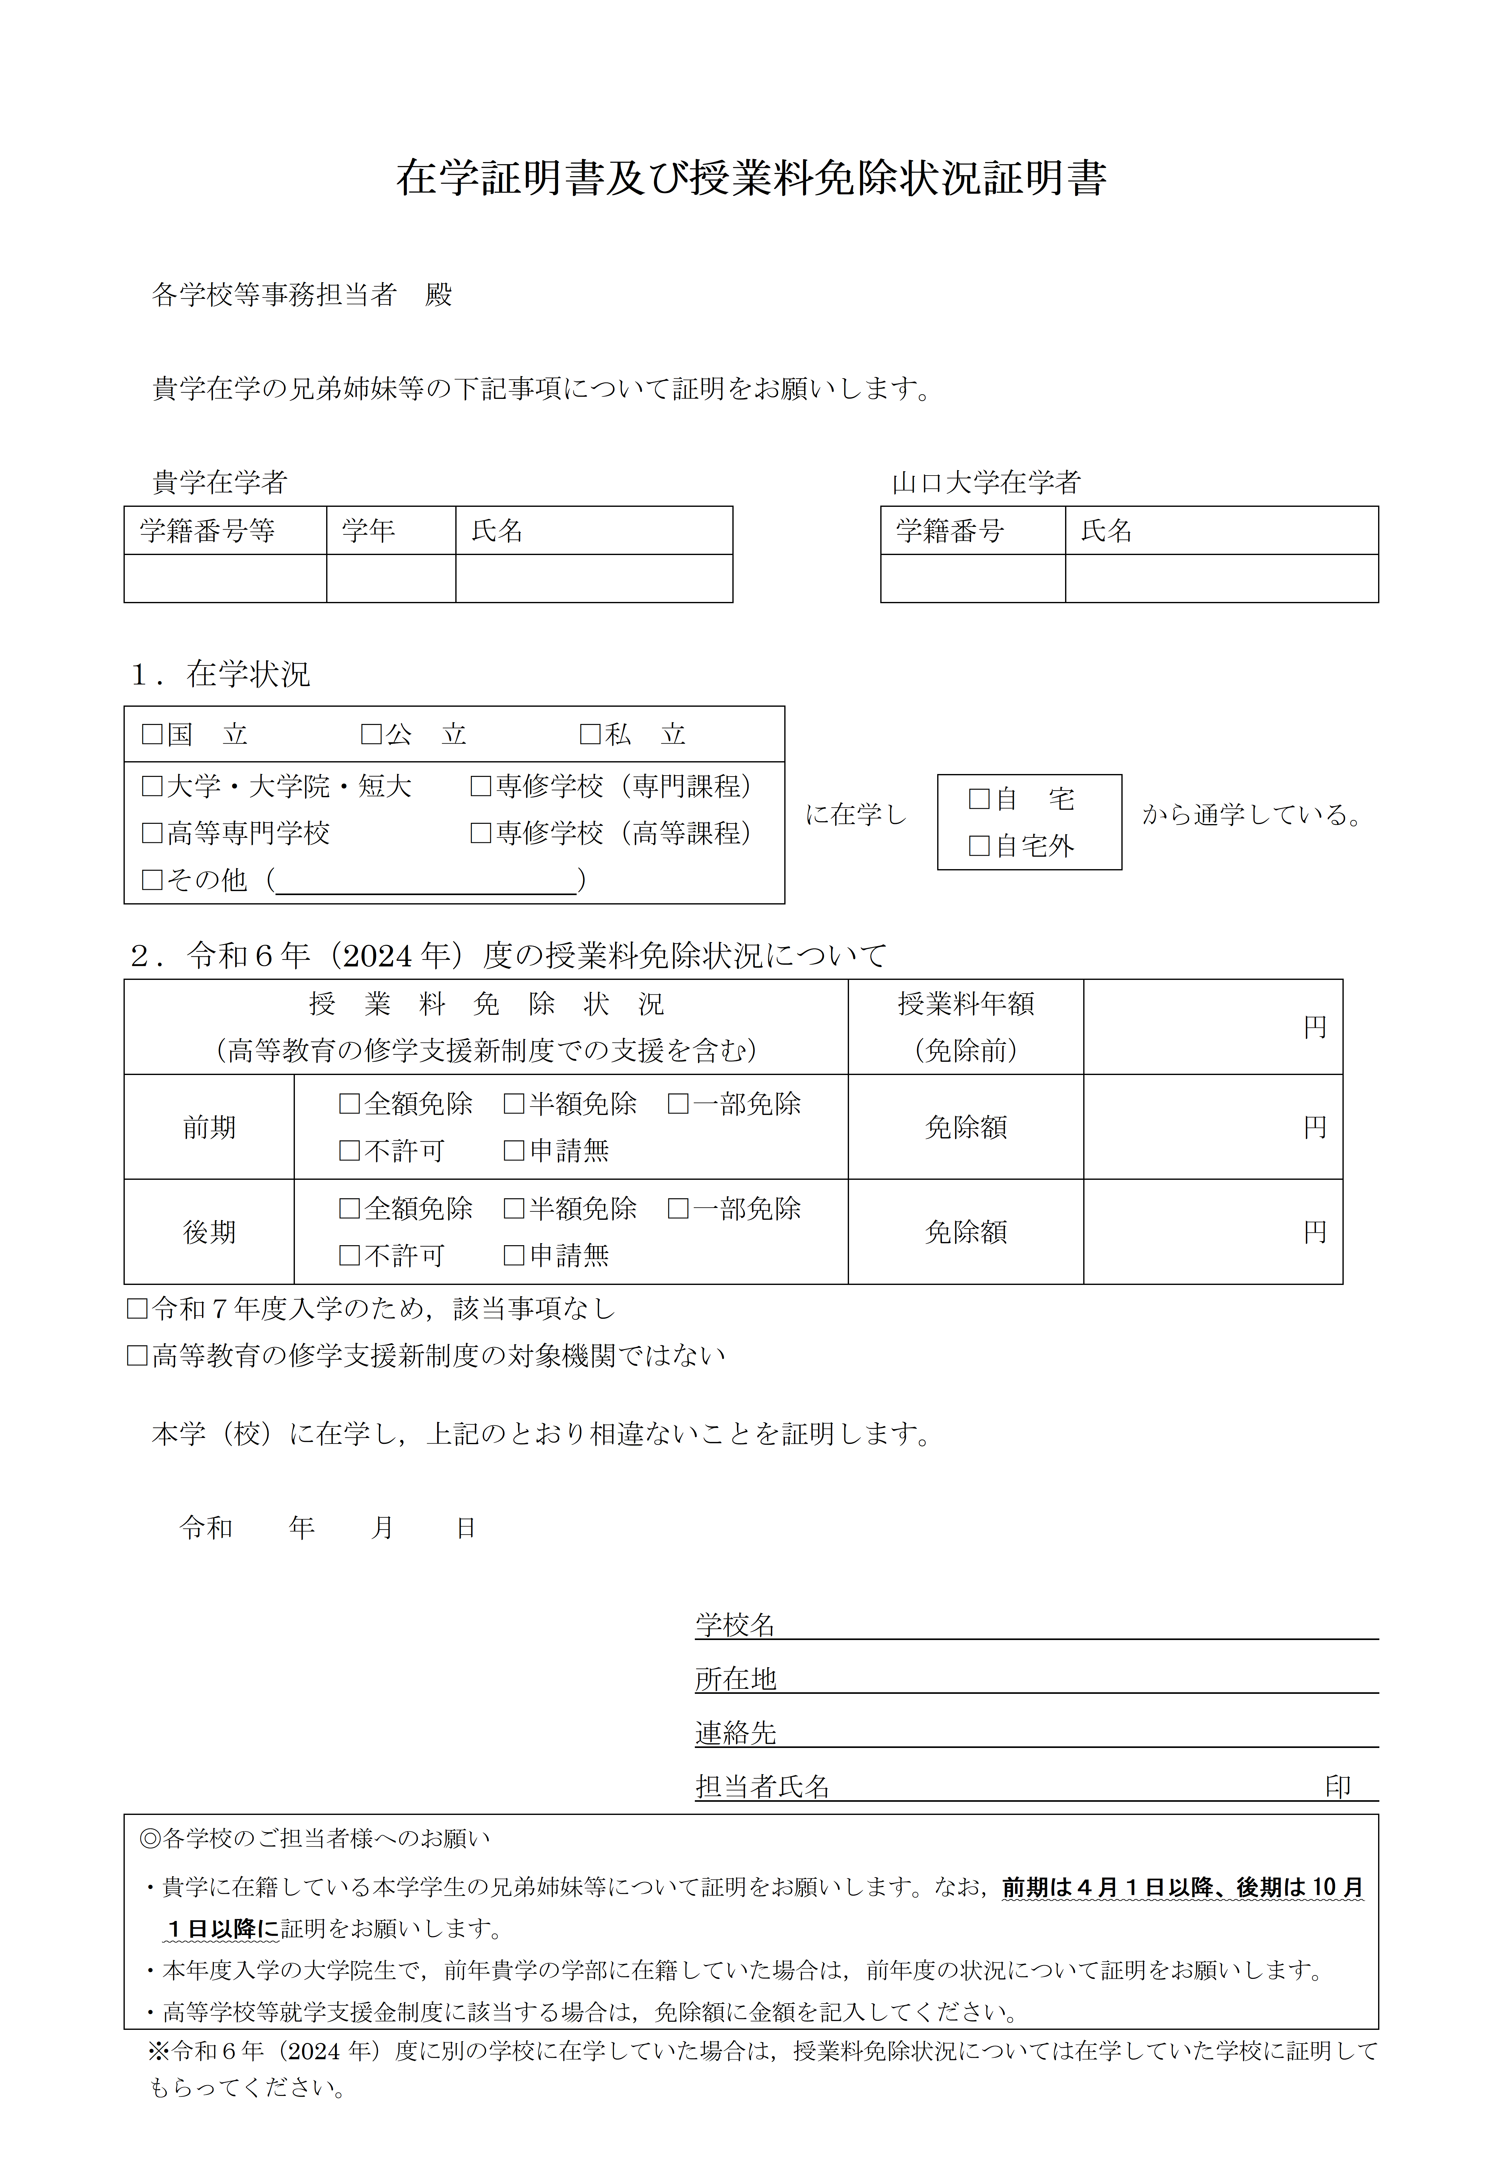

Slide 18
Deductible is available for long-term medical treatment of six months or more. However, the deductible is limited to medical expenses covered by health insurance and related to the name of the illness listed on the medical certificate. ✔Receipts must be organized by month and affixed to the affixing ledger. Unorganized or unclear receipts are not deductible. ✔Items for which it is unclear whether or not they are covered by health insurance are not deductible.

Slide 19
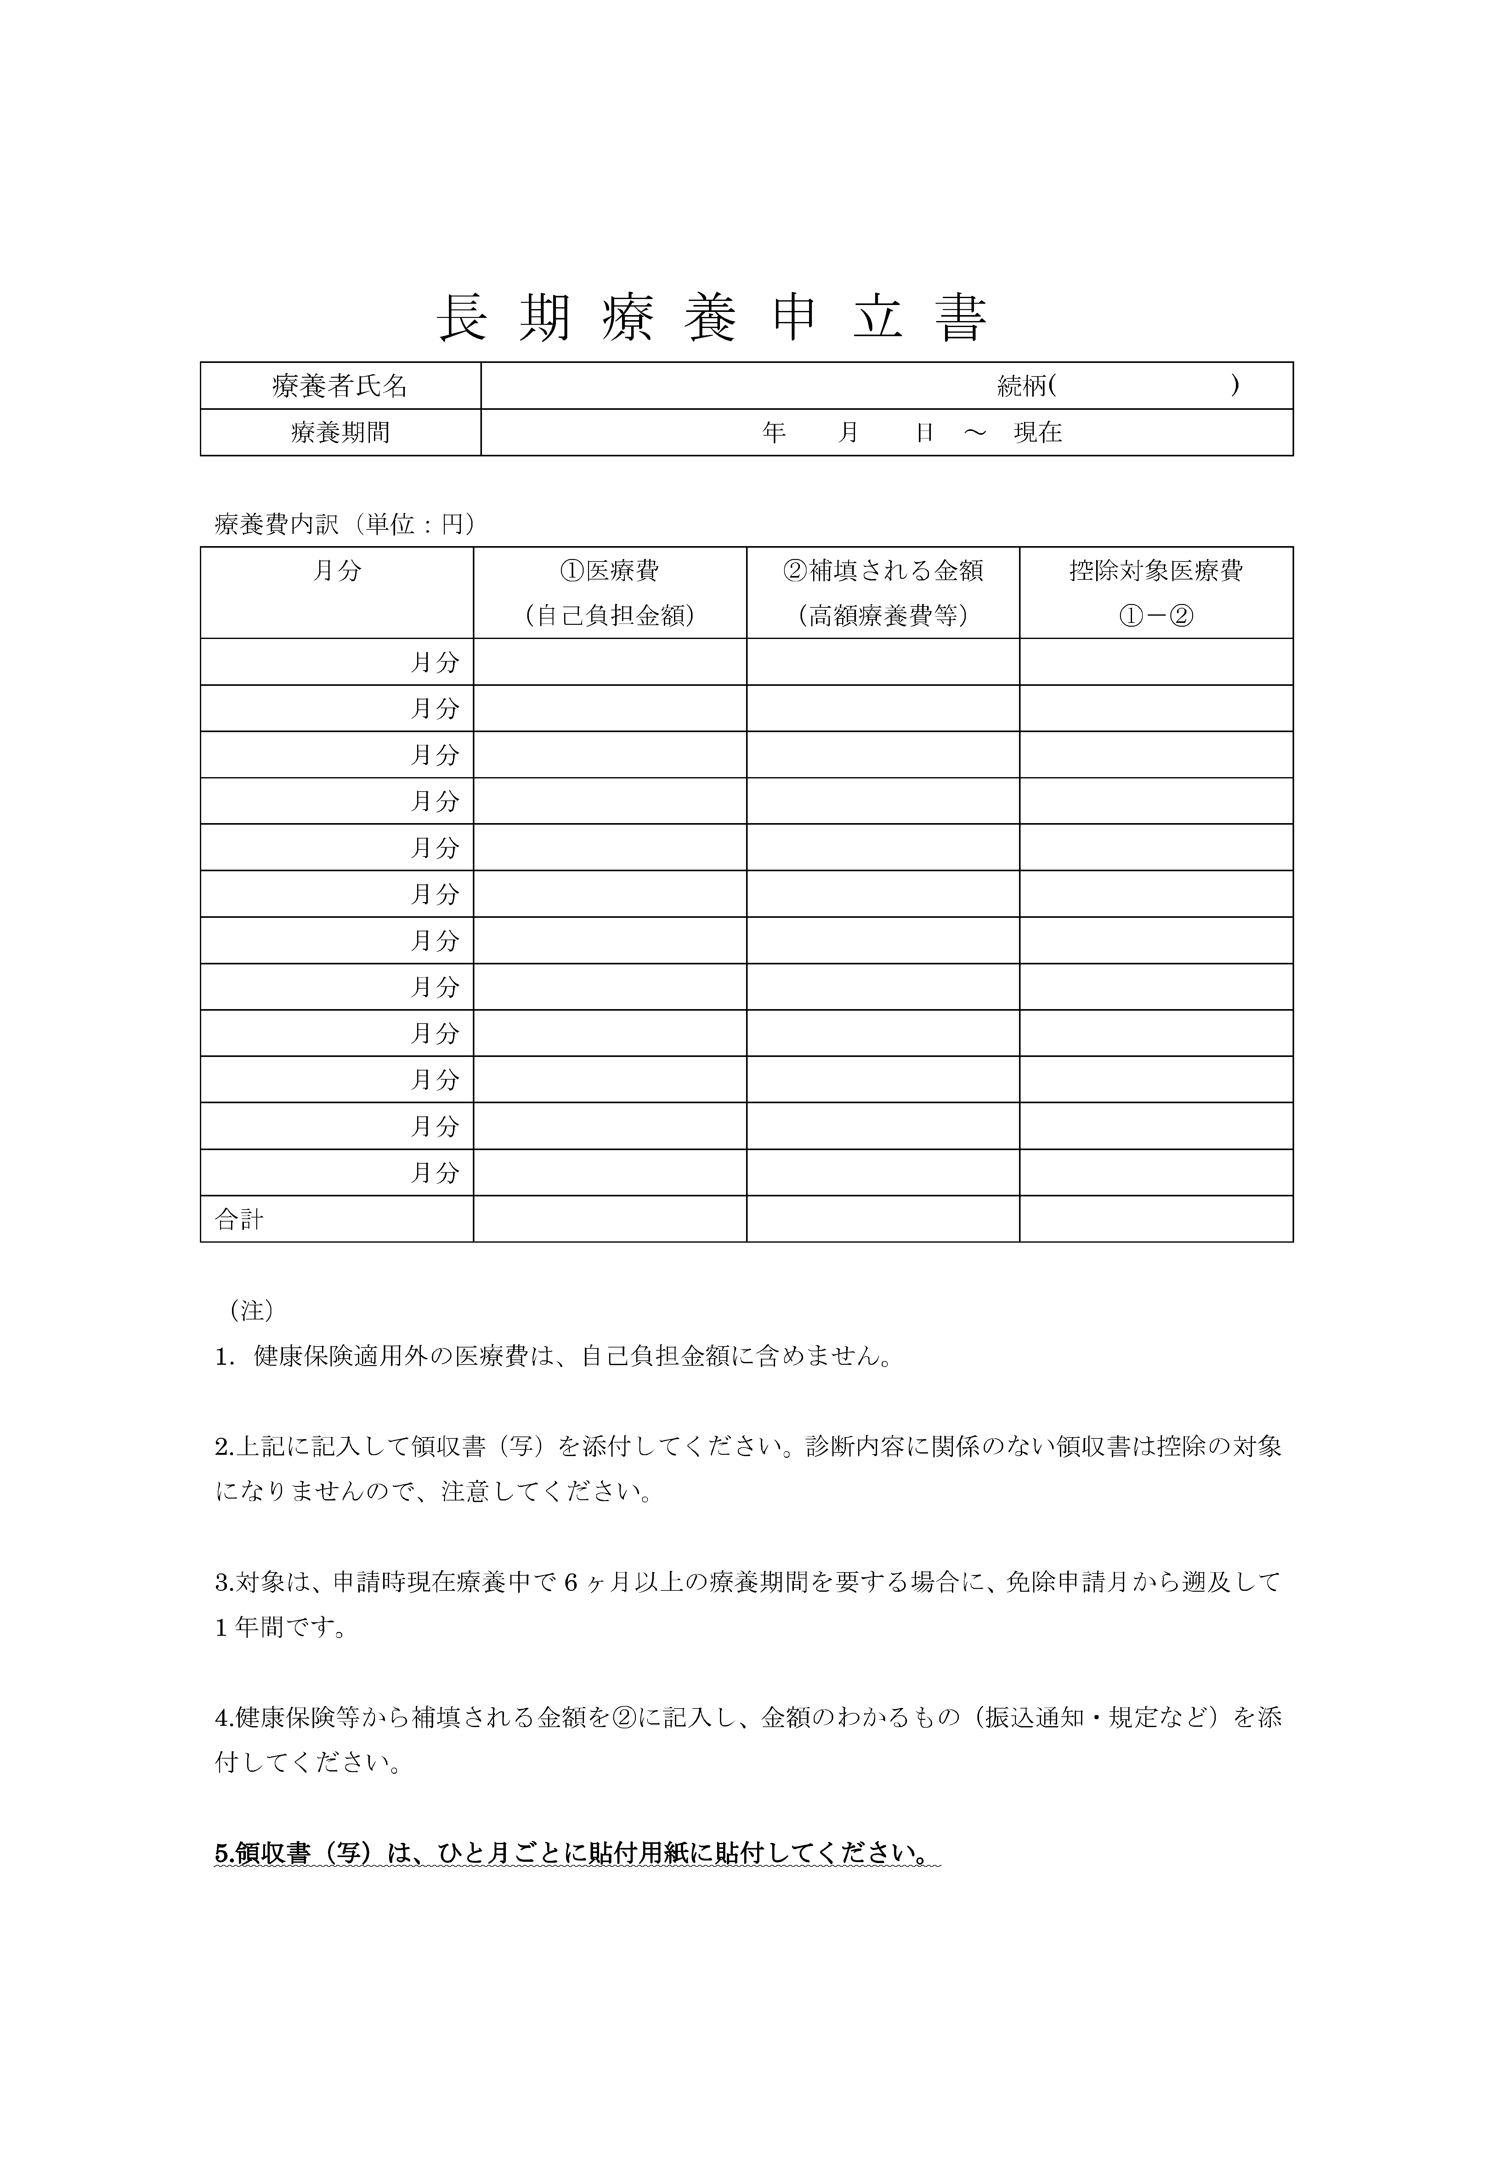

Slide 20
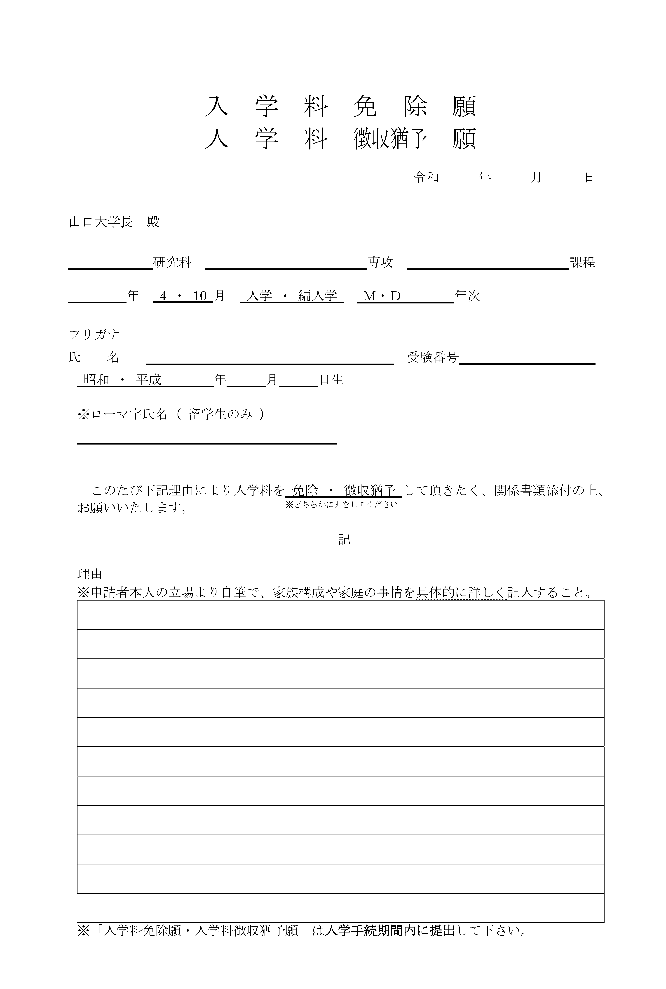
Please submit during the enrollment period.(Japanese version)

Slide 21
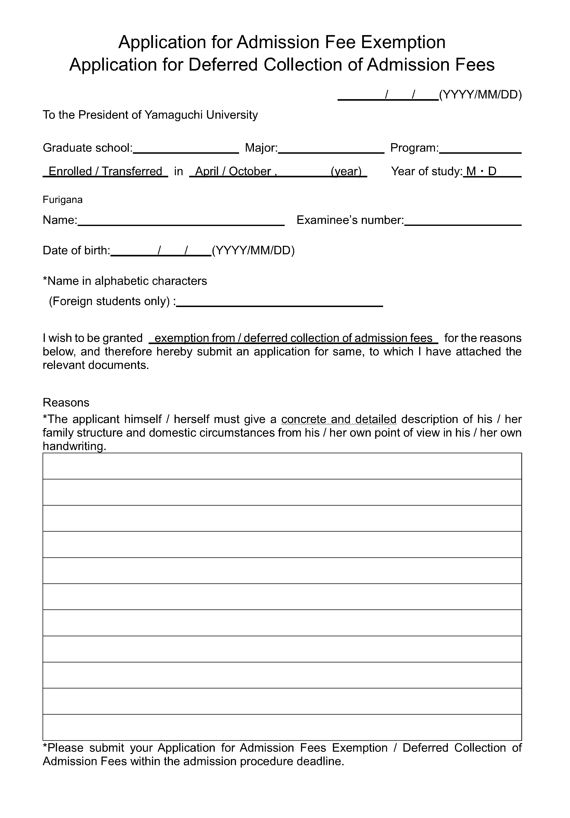
Please submit during the enrollment period.(English version)

Slide 22
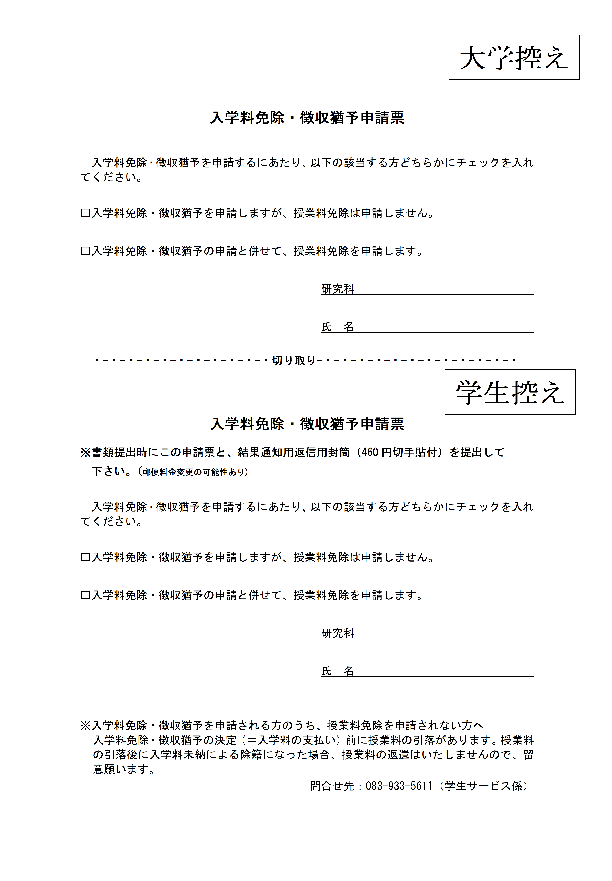
Please submit the application form together with the tuition fee waiver application form after the enrollment procedures.
Please submit the application form together with the tuition fee waiver application form after the enrollment procedures.

