Slide 1
（graduate students entering April 1 2025）
Application for Yamaguchi University Entrance Fee Waiver and Deferment of Collection and Tuition Fee Waiver for the Second semester of the 2025 academic year
（graduate students entering Oct.10 2025）
Admission Fee Waiver and Deferment System 2
Tuition fee exemption 4
Schedule for FY2025 6
Submission of documents
（１）Propose a mandatory category 9
（２）Documents related to income 10
（３）Documents related to deductions 12
（４）Other documents 12
【Form】
Proof of (expected)salary payment（給与等支給（見込）証明書） 14
Proof regarding retirement（退職に関する証明書） 16
Certificate of enrollment and certificate of tuition fee exemption status
（在学証明書及び授業料免除状況証明書） 18
Written statement of long-term recuperation（長期療養申立書） 20
Application for Admission Fee Exemption/Application for Deferred Collection of Admission
Fees(Japanese version)（入学料免除・入学料徴収猶予願・日本語版） 22
Application for Admission Fee Exemption/Application for Deferred Collection of Admission
Fees(English version) （入学料免除・入学料徴収猶予願・英語版） 23
Application form for entrance fee waiver and deferment（入学料免除・徴収猶予申請票） 24
Students in Yoshida campus：students support section, student affairs division(Yoshida campus)
（Tel）083-933-5611
（E-mail）ga113@yamaguchi-u.ac.jp

Slide 2
Admission Fee Waiver and Deferment System
１．Those who meet any of the following conditions are eligible to apply・・・Graduate students
（１） Students who have difficulty in paying the tuition fee by the deadline due to financial reasons and who are recognized as meeting certain academic criteria.
（２）【One year prior to enrollment】 Students those who have difficulty in paying tuition fees due to the following reasons.
・The person responsible for paying school expenses has died.
・The student or the person responsible for paying school expenses has suffered damage from a
disaster, such as a storm or flood in Japan.
２．Exemption Amounts
・Entrance fee waiver amount・・・Full or half of the entrance fee
・Deferment of Entrance Fee・・・Full of the entrance fee
３．About Application
Please note that there are 🔷two levels of acceptance.
（１）🔷During the enrollment process
Submission of documents ： 「Application for Admission Fee Exemption/Application for Deferred
Collection of Admission Fees」
（２）Preparation of required documents
Documents required for application for entrance fee waiver and deferment of entrance fee are
the same as those for application for tuition fee waiver.
（ⅰ） When apply for entrance fee waiver only, or, apply for both tuition fee waiver and entrance fee waiver
Please see page 9～12 of this handbook, and prepare the necessary documents.
It is not necessary to prepare two copies, one for tuition fee waiver and the other for admission
fee waiver, and prepare 「Application form for entrance fee waiver and deferment」,Envelope（長
形３号）（460 yen stamp is required）
When the submission period arrives, follow the procedure.(see 4 page 「２．（１）」)
（ⅱ） When apply for tuition fee waiver only
When the submission period arrives, follow the procedure.(see 4 page 「２．（１）」)

Slide 3
（３）🔷After Admission
（４）Notification of Admission fee waiver and Deferment Results
December 2025 (planed)
Exemption results will be sent by return envelope.
Those who are exempted or denied half the amount as a result of their application must pay
the relevant entrance fee by the deadline specified in the notification of the application result.
Submission period | October 6(Fri) , 2025 to October 10(Fri), 2025 ※Office Hours : 9:00 am～12：00pm、13:00pm～17：00pm
Submission of documents | Please see （２）
Submission counter | Students in Yoshida campus：students support section, student affairs division(Yoshida campus) tel:083-933-5611 Students in Kogushi campus：education/students support section, educational affairs division, faculty of medicine and health scienses (Kogushi campus) tel:0836-22-2099 Students in Tokiwa campus：students section , educational affairs division, faculty of engineering (Tokiwa campus) tel:0836-85-9011

Slide 4
Tuition fee exemption
１．Those who meet any of the following conditions are eligible to apply・・・Graduate students
（１） Students who have difficulty in paying the tuition fee by the deadline due to financial reasons and who are recognized as meeting certain academic criteria.
（２） 【One year prior to enrollment】 Students those who have difficulty in paying tuition fees due to the following reasons.
・The person responsible for paying school expenses has died.
・The student or the person responsible for paying school expenses has suffered damage from a
disaster, such as a storm or flood in Japan.
２．About Application
（１）How to apply
①Prepare necessary documents（See page 9 onward）
②After logging in, fill in the required information, print out the form「Application for
Tuition Fee Exemption 」「Family situation report」「Hearing report on the situation of the
applicant」
https://exemption.jimu.yamaguchi-u.ac.jp/exemption-request-system-for-student/login.jsf
③Submit to the above location
・Required documents prepared in ①
・「Application for Tuition Fee Exemption」②
・「Family situation report」②
・「Hearing report on the situation of the applicant」②
※Submission by mail or by anyone other than the applicant himself/herself will not be
accepted. The applicant must submit the application “in person” only.
（２）Application result notification
January 2026
Submission period | October 6(Fri) , 2025 to October 10(Fri), 2025 ※Office Hours : 9:00 am～12：00pm、13:00pm～17：00pm
Submission of documents | Please see page 9 onward
Submission counter | Students in Yoshida campus：students support section, student affairs division(Yoshida campus) tel:083-933-5611 Students in Kogushi campus：education/students support section, educational affairs division, faculty of medicine and health scienses (Kogushi campus) tel:0836-22-2099 Students in Tokiwa campus：students section , educational affairs division, faculty of engineering (Tokiwa campus) tel:0836-85-9011

Slide 5
３．In case of missing documents
After the application documents are submitted, if there are any missing documents, the University will ask the applicant to submit them by the deadline specified by the University. If you are contacted by phone or email to the applicant's official Yamaguchi University email address, please respond as soon as possible.
If the missing documents are not submitted by the deadline specified by the University, a written reminder will be sent. If the documents are not submitted by the deadline specified in the reminder letter, the application will be invalidated. Please keep this in mind.
４．Application Results and Tuition Payment
✔You can download the decision notice of the application result uploaded on the Tuition Waiver Student System. The date when the decision notice can be downloaded will be announced to the official Yamaguchi University email address.
✔ Applicants for tuition fee waiver should not pay the tuition fee since the payment of tuition fee will be deferred until the applicant is notified of the result of the application. In principle, tuition fees are non-refundable once paid.
✔ If payment of tuition fees is required as a result of the application, please confirm the details of the payment method, etc. in the result notification. Please note that failure to pay the tuition fee may result in expulsion from the program.
５．Precautions
✔Depending on the circumstances of the applicant and his/her family, the applicant may be asked to submit documents that are not listed as documents to be submitted. The applicant and his/her family may be asked to submit documents that are not listed as documents to be submitted.
✔If the information in the application documents is not true, the granting of the exemption may be revoked even after notification of the results of the application.
✔In the following cases, contact the Student Support Section, Student Support Division, as soon as possible.
（If the applicant takes a leave of absence or withdraws from school after application, or if there is a change in the applicant‘s contact information）
✔After submitting the application documents, please notify the Student Services Section of the Student Support Division as soon as possible if there is a change in your family's financial situation due to a change in employment, or if there is a change in your family's financial situation due to a family member living in the same household becoming independent.
✔If you are unable to apply in person during the application period due to study abroad, etc., please contact the Student Services Section before you go to study abroad.
✔Once submitted, documents cannot be returned or viewed.

Slide 6
Schedule for FY2025
Students enrolled in April | Tuition fee exemption | Admission Fee Waiver
① before entering school
During the enrollment process |  | Please submit the「Application for admission fee exemption/Application for deferred collection of admission fees」
② after entering school（First semester）
April 14 ～ April 18 | （ⅰ）When apply for entrance fee waiver only, or, apply for both tuition fee waiver and entrance fee waiver Please submit the following documents. ・「necessary documents 」 ・「Application for Tuition Fee Exemption 」 ・「Family situation report」 ・「Hearing report on the situation of the applicant」 ・「Application form for entrance fee waiver and deferment」 ・Envelope（長形３号）（460 yen stamp is required） We will contact you if any documents are missing. （ⅱ）When apply for tuition fee waiver only Please submit the following documents. ・「necessary documents 」 ・「Application for Tuition Fee Exemption 」 ・「Family situation report」 ・「Hearing report on the situation of the applicant」 We will contact you if any documents are missing.
Mid July |  | We will send notification of the results of the entrance fee waiver. Students who are not approved or who are approved for half of the entrance fee must pay the designated entrance fee by the due date.
Early Aug | Students who are not fully exempted from the tuition fee must pay the designated tuition fee by the end of August after confirming the result of the exemption through the Tuition Fee Exemption Student System or webmail.
② after entering school（second semester）
August | Please submit the following documents. ・「necessary documents 」 ・「Application for Tuition Fee Exemption 」 ・「Family situation report」 ・「Hearing report on the situation of the applicant」 We will contact you if any documents are missing.
January of the following year | Students who are not fully exempted from the tuition fee must pay the designated tuition fee by the end of January after confirming the result of the exemption through the Tuition Fee Exemption Student System or webmail.
It is not necessary to prepare two copies, one for tuition fee waiver and the other for admission fee waiver.
済
Students enrolled in Oct | Tuition fee exemption | Admission Fee Waiver
① before entering school
During the enrollment process |  | Please submit the「Application for admission fee exemption/Application for deferred collection of admission fees」
② after entering school（second semester）
October ６ ～ October １０ | （ⅰ）When apply for entrance fee waiver only, or, apply for both tuition fee waiver and entrance fee waiver Please submit the following documents. ・「necessary documents 」 ・「Application for Tuition Fee Exemption 」 ・「Family situation report」 ・「Hearing report on the situation of the applicant」 ・「Application form for entrance fee waiver and deferment」 ・Envelope（長形３号）（460 yen stamp is required） We will contact you if any documents are missing. （ⅱ）When apply for tuition fee waiver only Please submit the following documents. ・「necessary documents 」 ・「Application for Tuition Fee Exemption 」 ・「Family situation report」 ・「Hearing report on the situation of the applicant」 We will contact you if any documents are missing.
Mid-December |  | We will send notification of the results of the entrance fee waiver. Students who are not approved or who are approved for half of the entrance fee must pay the designated entrance fee by the due date.
January of the following year | Students who are not fully exempted from the tuition fee must pay the designated tuition fee by the end of January after confirming the result of the exemption through the Tuition Fee Exemption Student System or webmail.
It is not necessary to prepare two copies, one for tuition fee waiver and the other for admission fee waiver.

Slide 8
The following paragraphs and thereafter are a list of required documents.

Slide 9
６-（１）Propose a mandatory category･･･ submit documents marked with an asterisk (★) in the appropriate category
・Documents must be submitted for all family members of the same household.
・If you are an international student receiving remittances, please refer to (4). Some documents need to be submitted separately.
・In cases you do not have all three items circled in blue, your application will not be accepted.
Classification |  |  | Necessary documents | Matters that require attention
General Students | Privately-financed foreign student | Person who earns his living by working alone
★ | ★ | ★ | Application for Tuition Fee Exemption(original) | After entering the information into the system, print it out.
★ | ★ | ★ | Family situation report(original) | After entering the information into the system, print it out.
★ | ★ | ★ | Income and taxation certificate（2024）(original) | Required for all family members of the same household. However, foreign students not residing in Japan as of January 1, 2024 are not required to submit this form.
 | ★ | ★ | Hearing Report on the Situation of the Applicant(original) | After entering the information into the system, print it out.
 | ★ |  | Photocopy of Residence Card (both sides)(copy) | All members of the same Lifecare family are required to share.
 | ★ |  | Photocopy of Health Insurance Card(copy) or Certificate of eligibility(copy) or Certificate of eligibility notice(copy) | All members of the same Lifecare family are required to share.
 |  | ★ | Documents to show that the applicant is no longer dependent under the Income Tax Law
Please see the next page if you are applying for the second semester 2025 tuition
waiver for the first time
If you earn any kind of income, such as salary, you will need to submit the “Documents related to income” on the next page.
NEXT！

Slide 10
６-（２）Documents related to income
.・Documents must be submitted for all family members of the same household.
Classification | Necessary documents | Matters that require attention | Issuing Institution, etc.
Currently working | Please see simplified flowchart | ・TA and RA at Yamaguchi University are also included in the part-time work ・「Proof of (expected)salary payment」 【form】14-15page ・「Proof regarding retirement」 【form】16-17page | Place of employment
～Simplified Flowchart～ | ～Documents～
START
Salary from employer
YES
Employed since before 2024.1.2
at same place of work and in the same employment
YES
Employment status is regular
YES
・Withholding Tax Certificate
for the year 2024 (copy)
・Withholding Tax Certificate
for the year 2024 (copy)
or
・Payslips for the most recent three(3) months(copy)
NO
NO
Newly employed or changed jobs
since 2024.1.2
or
Employment status has changed
since 2024.1.2.
Employment status is regular or Non-regular employment with bonus
≪Need both≫
YES
YES
・「Proof of (expected)salary payment」
（original）
・「Proof regarding retirement」
（original）
※If you were previously employed
regular and left after 2025.4.1
NO
Employment status other than regular and no bonus accrual
YES
・「Proof of (expected)salary payment」（original）
or
・Payslips for the most recent three(3) months(copy)
NEXT！

Slide 11
６-（２）Documents related to income
.・Documents must be submitted for all family members of the same household.
Classification | Necessary documents | Matters that require attention | Issuing Institution, etc.
Recipients of employment insurance / unemployment benefits | Employment insurance qualified recipient’s identificationcard(front/back)(copy) | Please submit the basic daily fee and the number of remaining days. | Hello work
Pension and Benefit Recipients | Withholding record for pensions for 2024 (copy) |  | Japan Pension Service, etc.
Disability pension recipients and survivors' pension recipients | Pension payment (remittance) notice (copy) or pension amount revision notice (copy) |  | Japan Pension Service, etc.
Child Allowance Recipients | A notification regarding child allowance showing the amount(copy) | If the child allowance is included in the salary, a copy of the paycheck stub showing this fact (copy of pay ) | Municipal office
Child Support Allowance recipients | ・Child rearing allowance certificate(copy) ・Notification regarding decision with regard to child rearing allowance amount(copy) ・Notification regarding revision with regard to child rearing allowance amount(copy) |  | Municipal office
Special Child Support Allowance recipients | ・Special child rearing allowancecertificate(copy) ・Notification regarding decision with regard to special child rearing allowance amount(copy) ・Notification regarding revision with regard to special child rearing allowance amount(copy) |  | Municipal office
Recipients of sickness and injury benefits | Notification regarding decision with regard to sickness and injury allowance(copy) |  | Insurer
Life Protection Recipients | Latest welfare decision (change) notification (copy) |  | Municipal office
Income other than from salary (Income from business, agriculture, real estate, interest and dividends, and miscellaneous income) | 【If you are filing a tax return】 ・The tax return form(2024)1,2,3(copy) 【If you are filing a citizen's or prefectural tax return】 ・The tax return for the fiscal year of 2025 and the municipal tax and the prefectural tax(copy) | If you changed your business or started your business after January 2024, please submit “documents showing income and necessary expenses for the last 3 months (any form)” in addition to the documents listed on the left. | Tax office municipal office
If you have resigned from your job | 「Proof regarding retirement」(original) | 【form】16-17page | Former Employer
In the event of the death of the person who bears the burden of school expenses, etc.(after October 1,2024) | ・A copy of a death certificate or other document that confirms death ・「Proof regarding retirement」 (original) ・A certificate of payment of life insurance benefits (copy) ・A certificate of survivor's pension(copy) ・A notice of pension payment (transfer) , or a notice of pension revision(copy) |  | Medical institution Former Employer nsurance companies, etc.

Slide 12
６-（３）Documents related to deductions
・If you wish to claim the following deductions, please submit the appropriate documentation.
・If the documents are not submitted by the deadline specified by the University, the deduction will not be applied.
Classification | Necessary documents | Matters that require attention | Issuing Institution, etc.
If the applicant's siblings are enrolled in a university (junior college), college of technology, or special training college (vocational or advanced course) | 「Certificate of enrollment and certificate of tuition fee exemption status」(original) | 【form】18-19page | Being in school
If you have a physical or mental disability | Disability certificate |  | Municipal office
If the patient is in long-term care for more than 6 months | ・「Written statement of long-term recuperation」(original) ・Medical certificate from a doctor confirming that the applicant has been under medical treatment for more than 6 months and is still under (original) ・Receipts for the most recent year(copy) ・If you received compensation for high-cost medical care, etc., an indication of the amount(copy) | 【form】20-21page | Medical institution insurance association
When the applicant or the person responsible for the school expenses has suffered a disaster in Japan *On and after October 1, 2024 | ・Disaster victim certificate(original) ・Valuation certificate(original) |  | Municipal office
６-（４）Other documents
Classification | Necessary documents | Matters that require attention
2024 Scholarship Recipients | Scholarship acceptance letter(copy) | Please submit proof of the amount received.
If you are an international student and have money to send home | Documents that prove the amount of money sent for support (copy)
International students receiving a scholarship from their home country | Acceptance letter for scholarship in your own country(copy)

Slide 13
The next and following pages are a collection of forms.
Please print and use the form without “sample” if necessary.

Slide 14
✔Please submit the original. ✔The fields for the employer in the red box are to be filled in by the employer.
Business establishment entry field

Slide 15
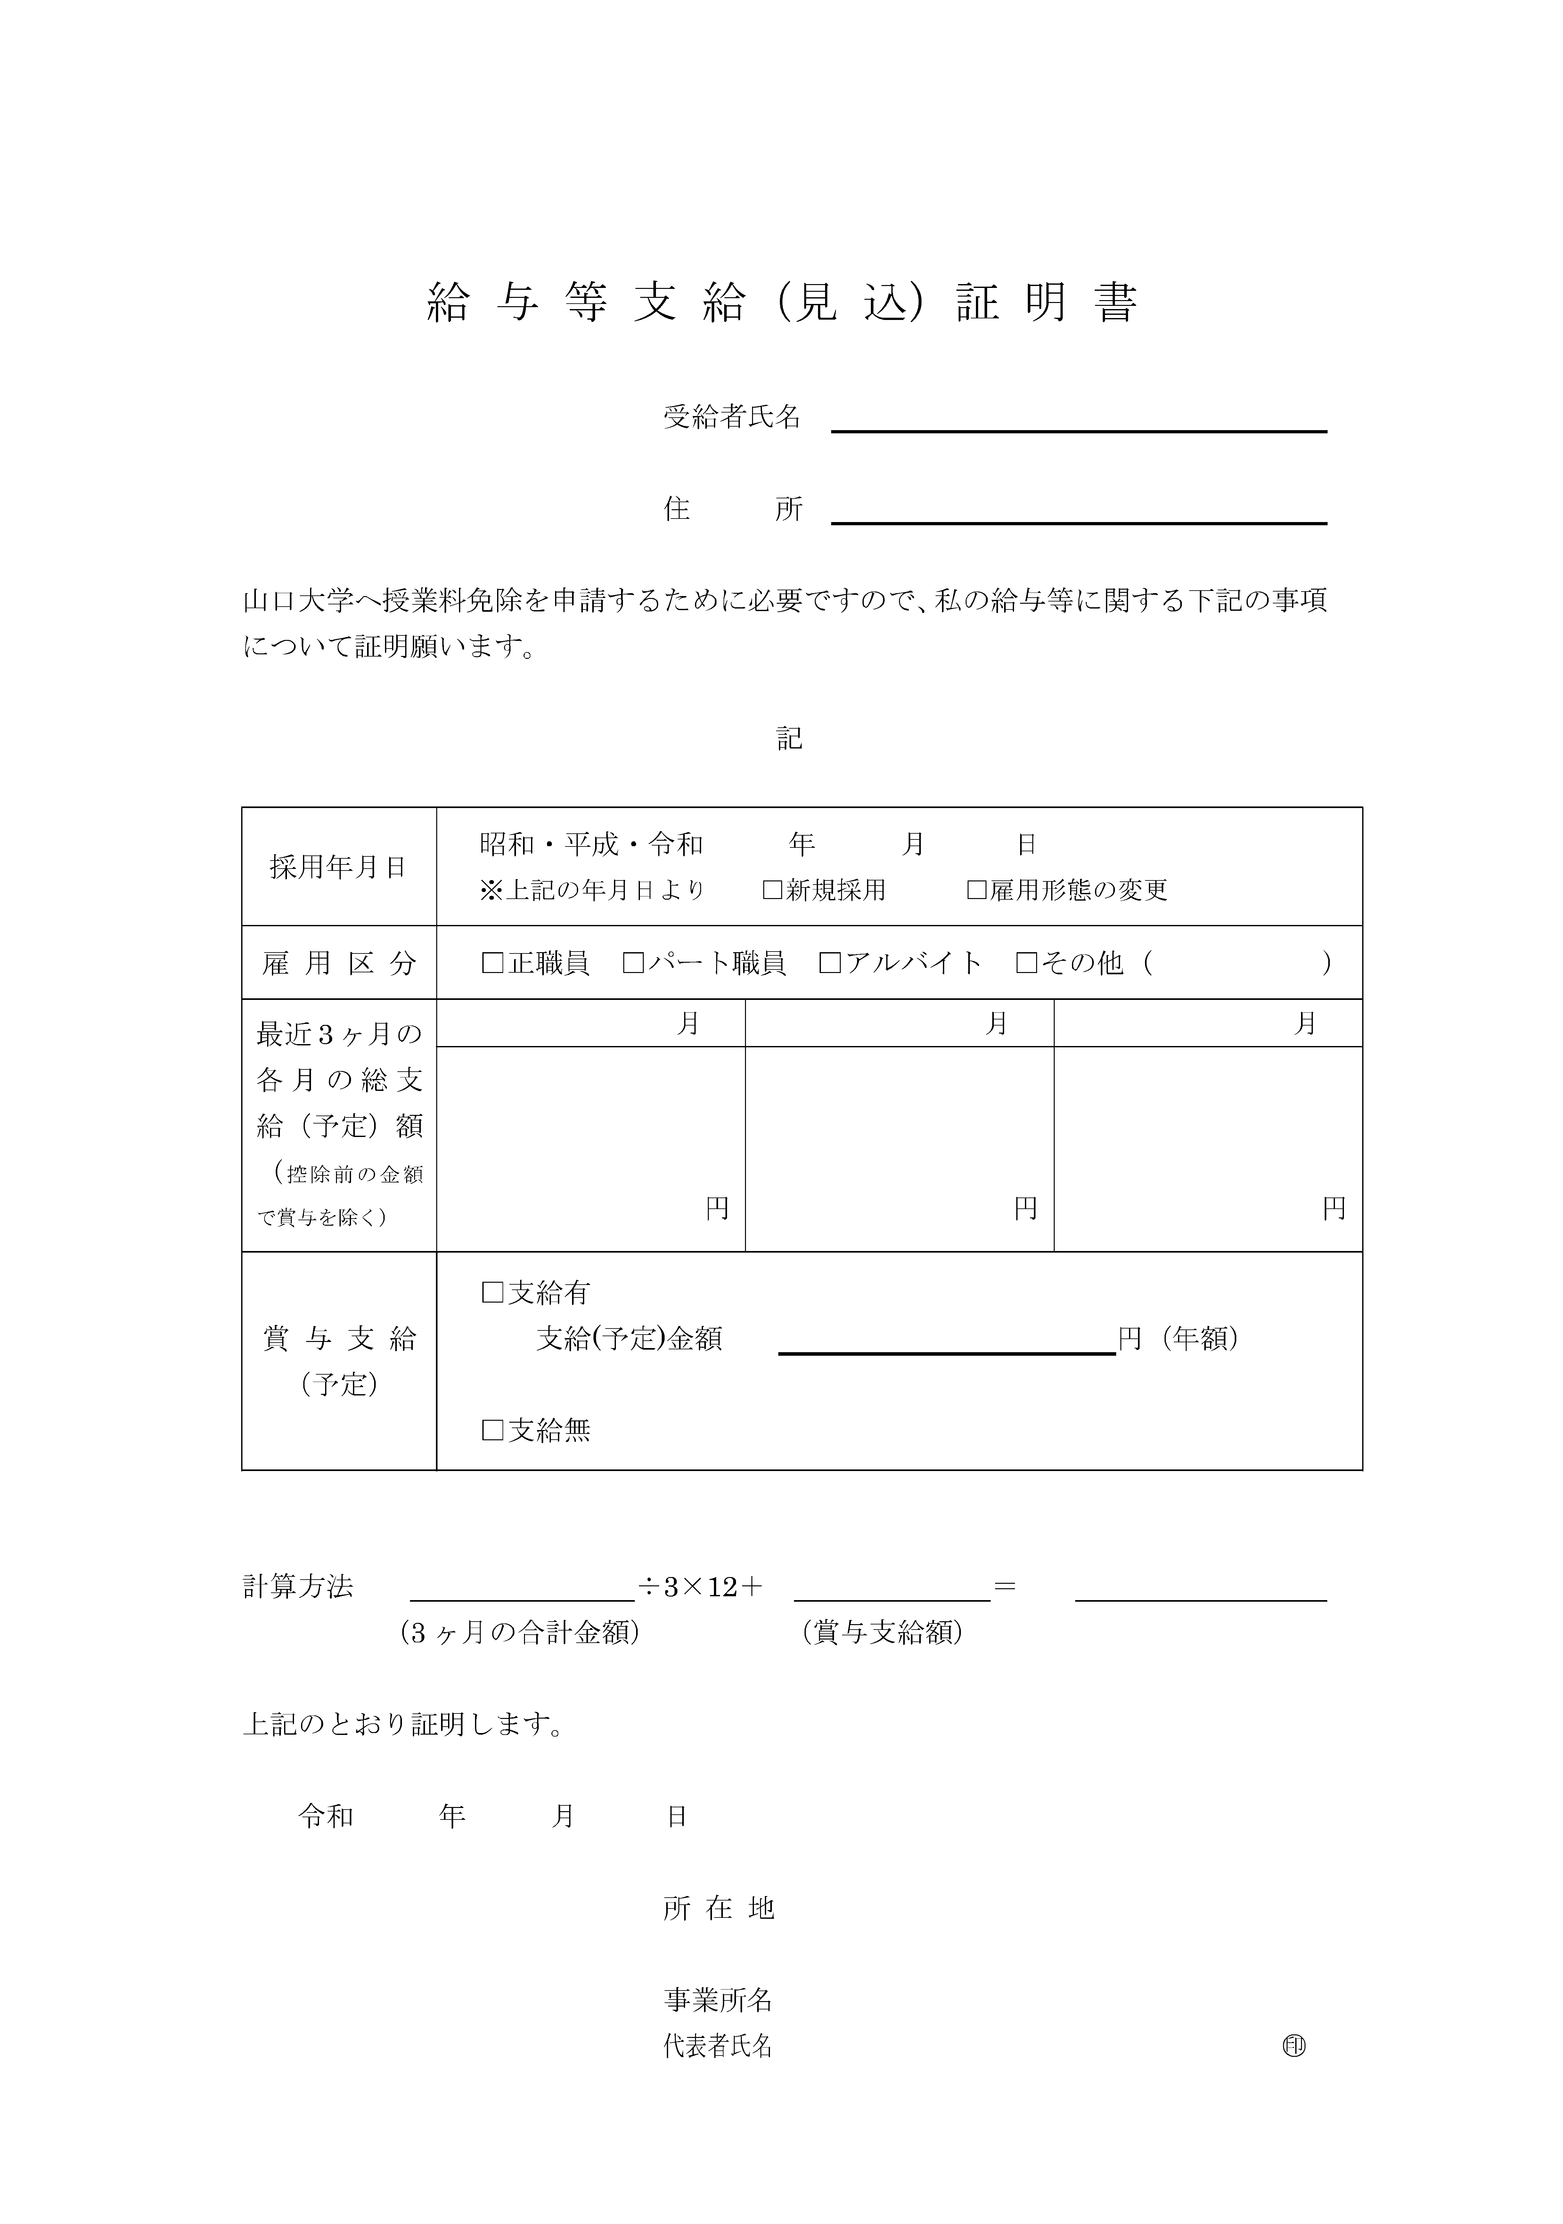

Slide 16
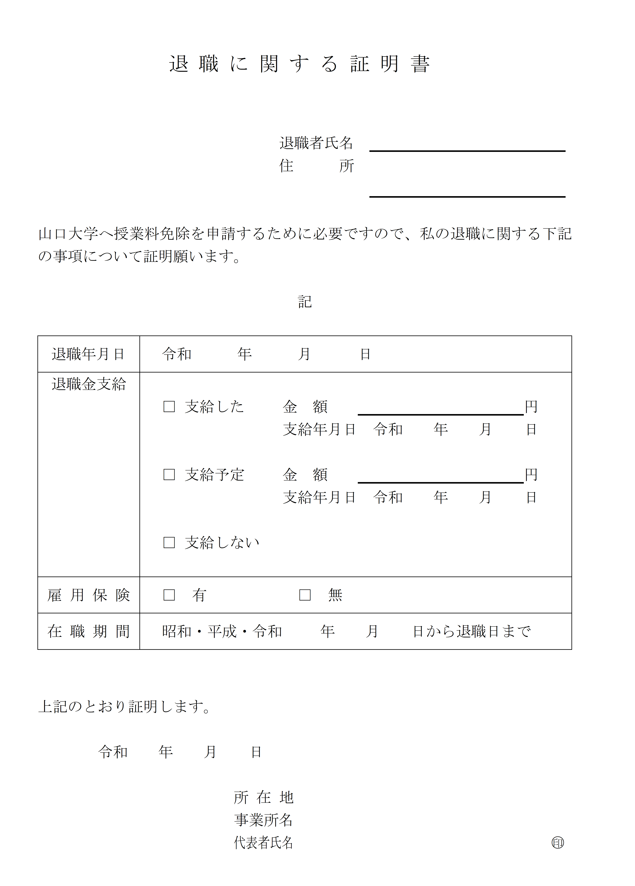
✔Please submit the original. ✔The fields for the employer in the red box are to be filled in by the employer.
Business establishment entry field

Slide 18
If the applicant‘s siblings are enrolled in a university (junior college), college of technology, or special training school (vocational or advanced course), they are eligible for the deduction. ✔「貴学在学者」・・・ Provide information about your siblings ✔「山口大学在学者」・・・ Provide information about The applicant himself/herself
School entry field
Enter a date after October 1, 2025

Slide 19
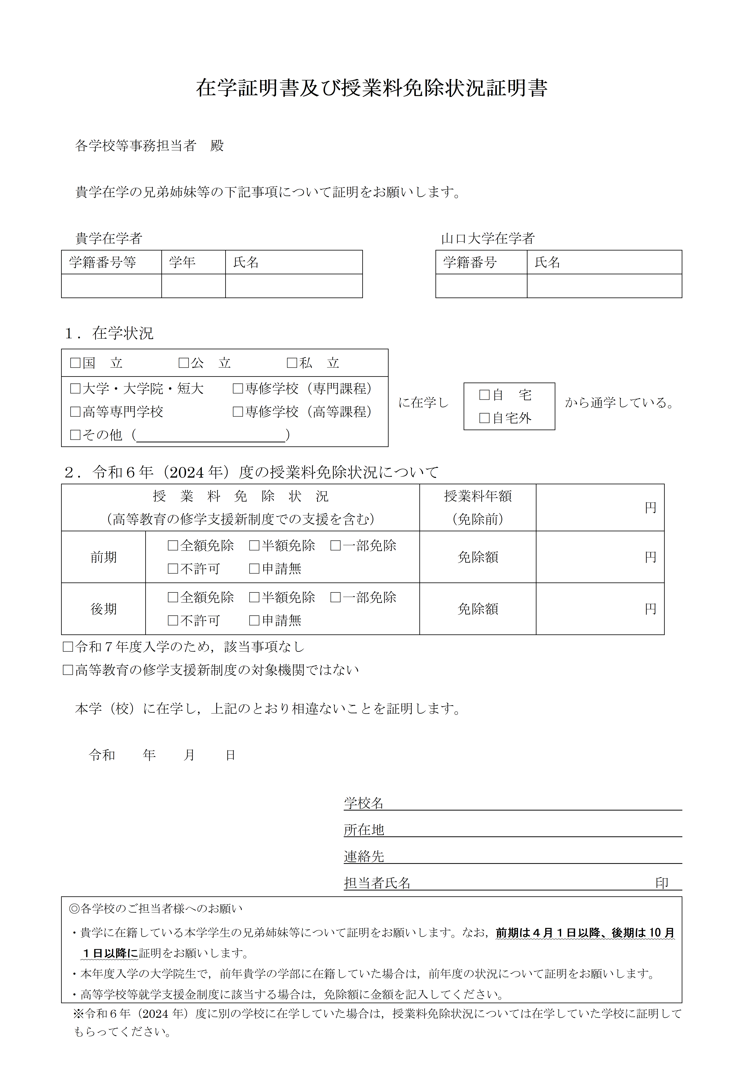

Slide 20
Deductible is available for long-term medical treatment of six months or more. However, the deductible is limited to medical expenses covered by health insurance and related to the name of the illness listed on the medical certificate. ✔Receipts must be organized by month and affixed to the affixing ledger. Unorganized or unclear receipts are not deductible. ✔Items for which it is unclear whether or not they are covered by health insurance are not deductible.

Slide 22
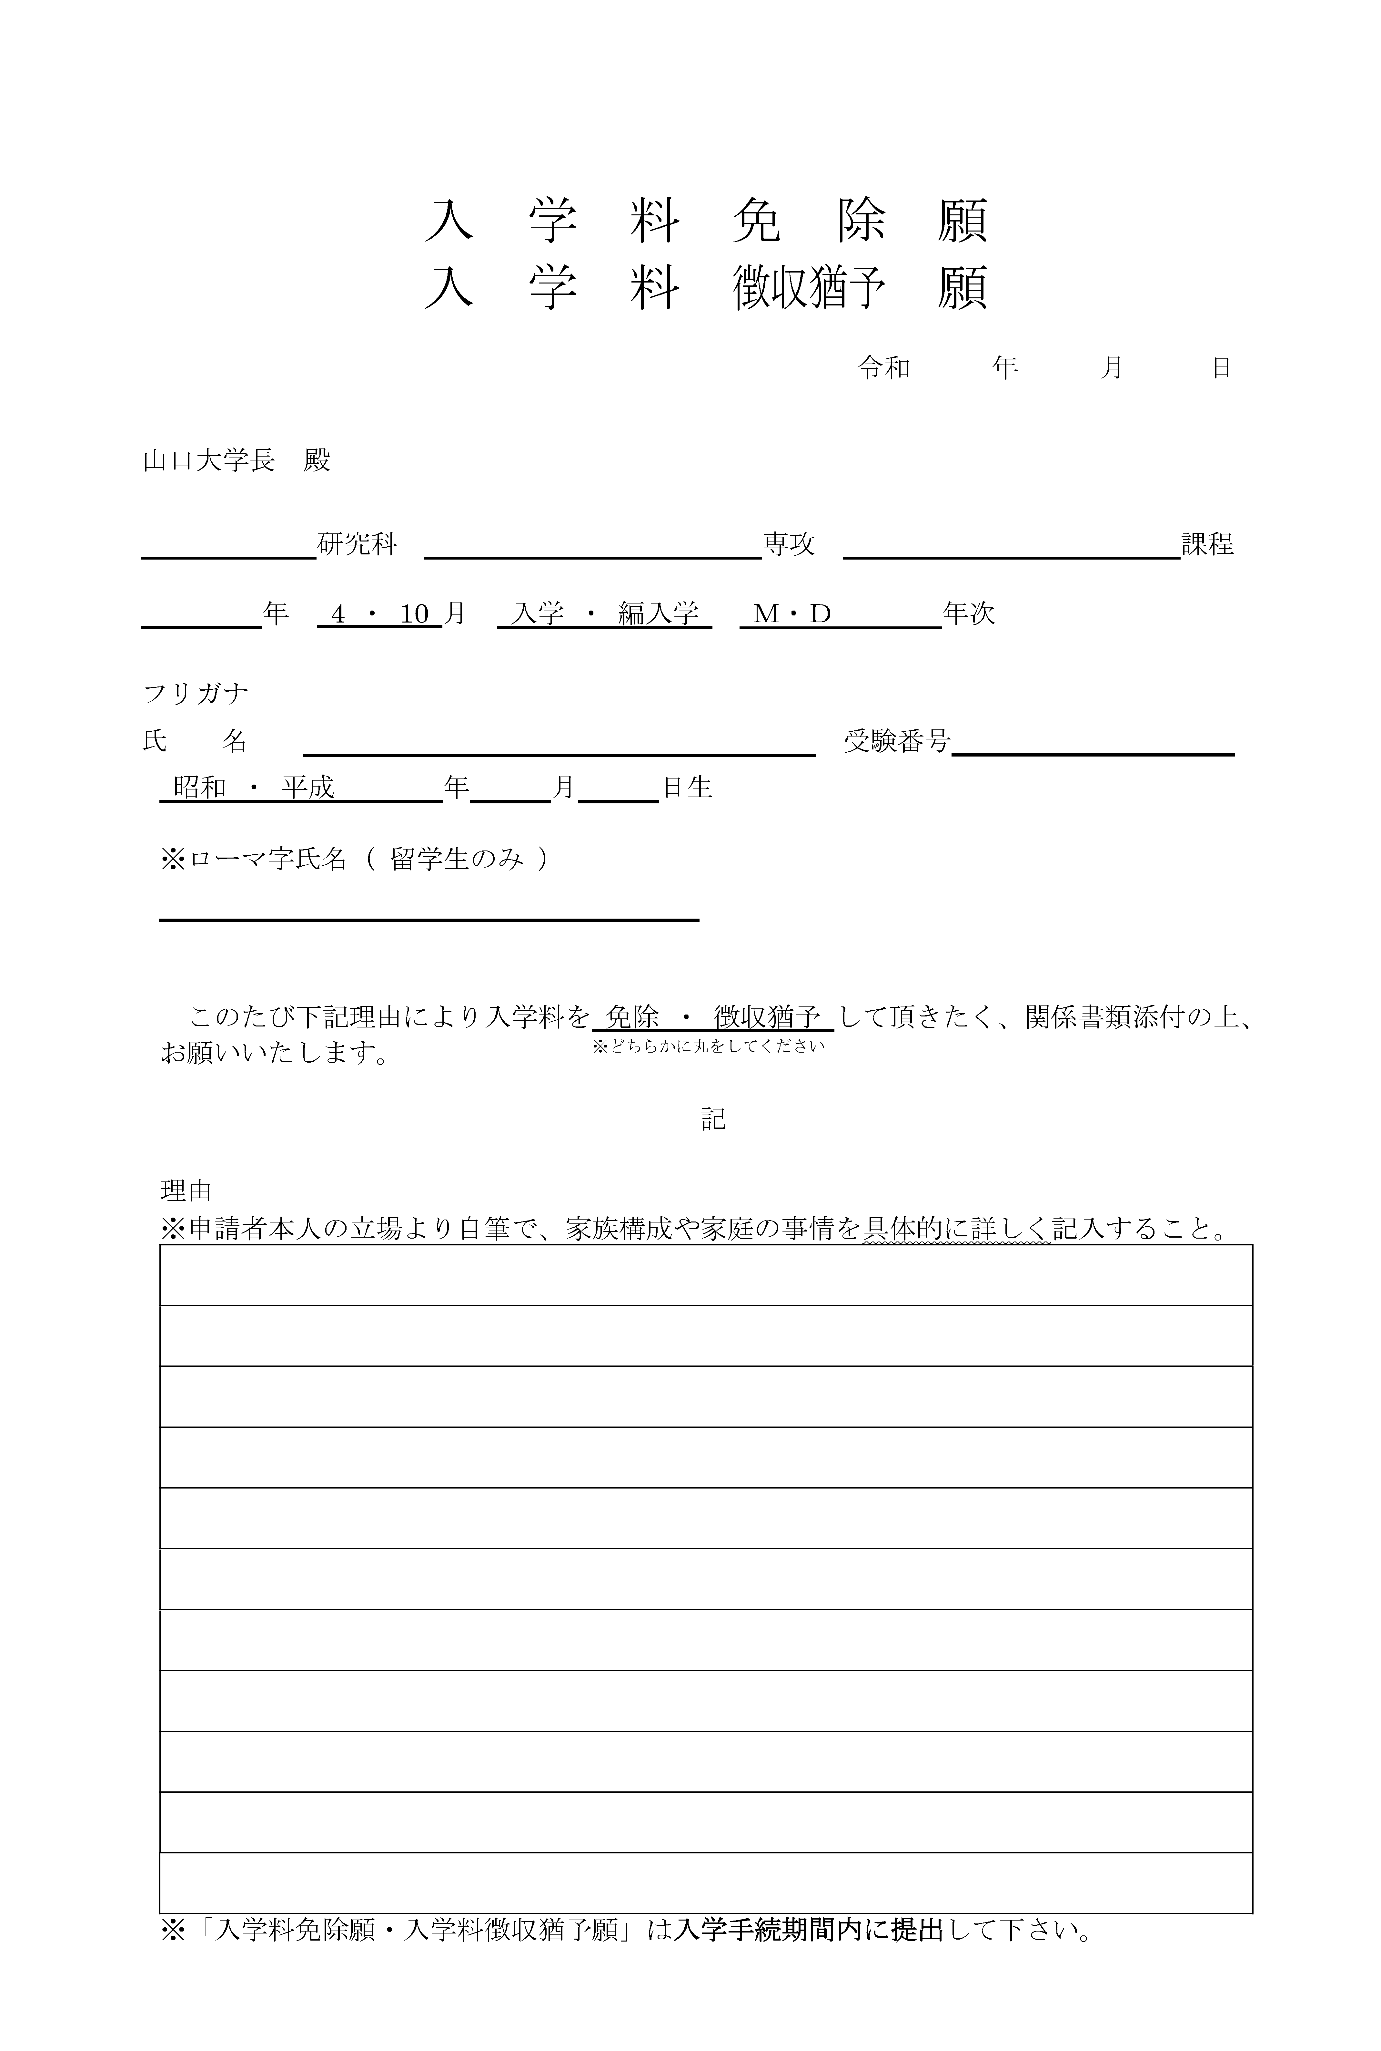
Please submit during the enrollment period.(Japanese version)

Slide 23
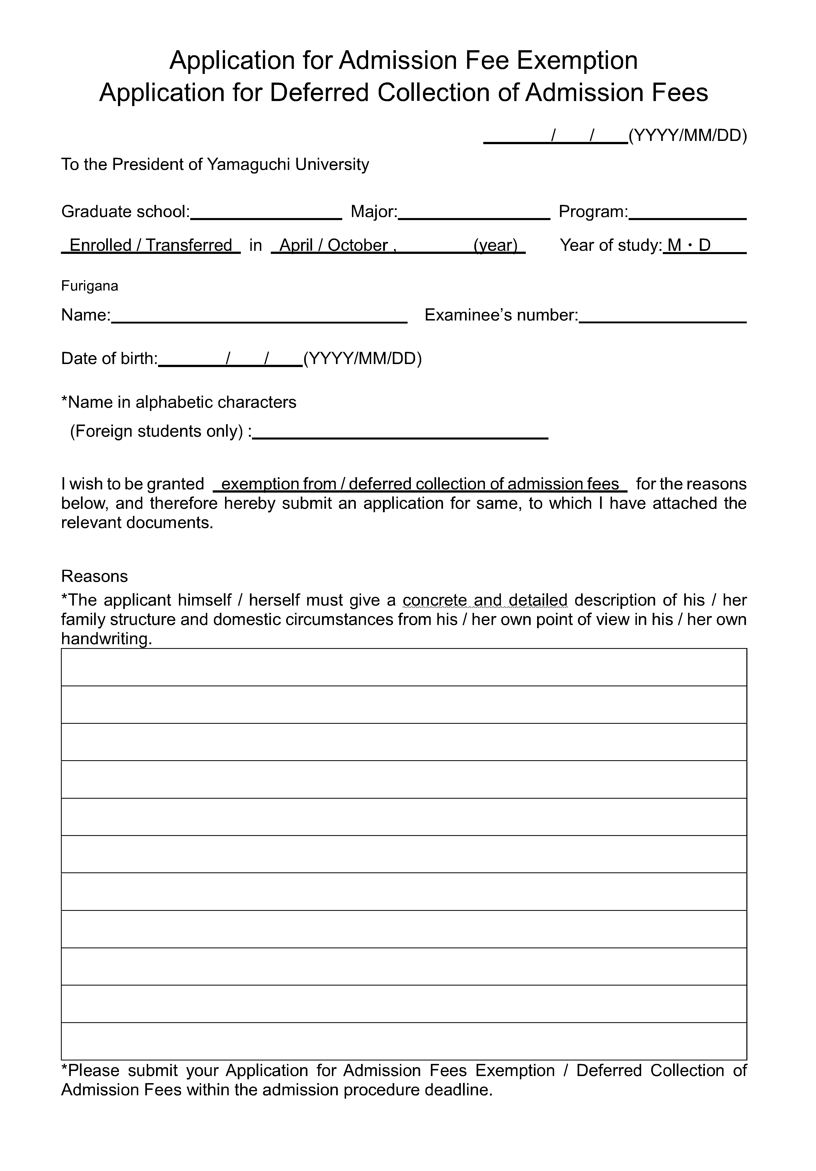
Please submit during the enrollment period.(English version)

Slide 24
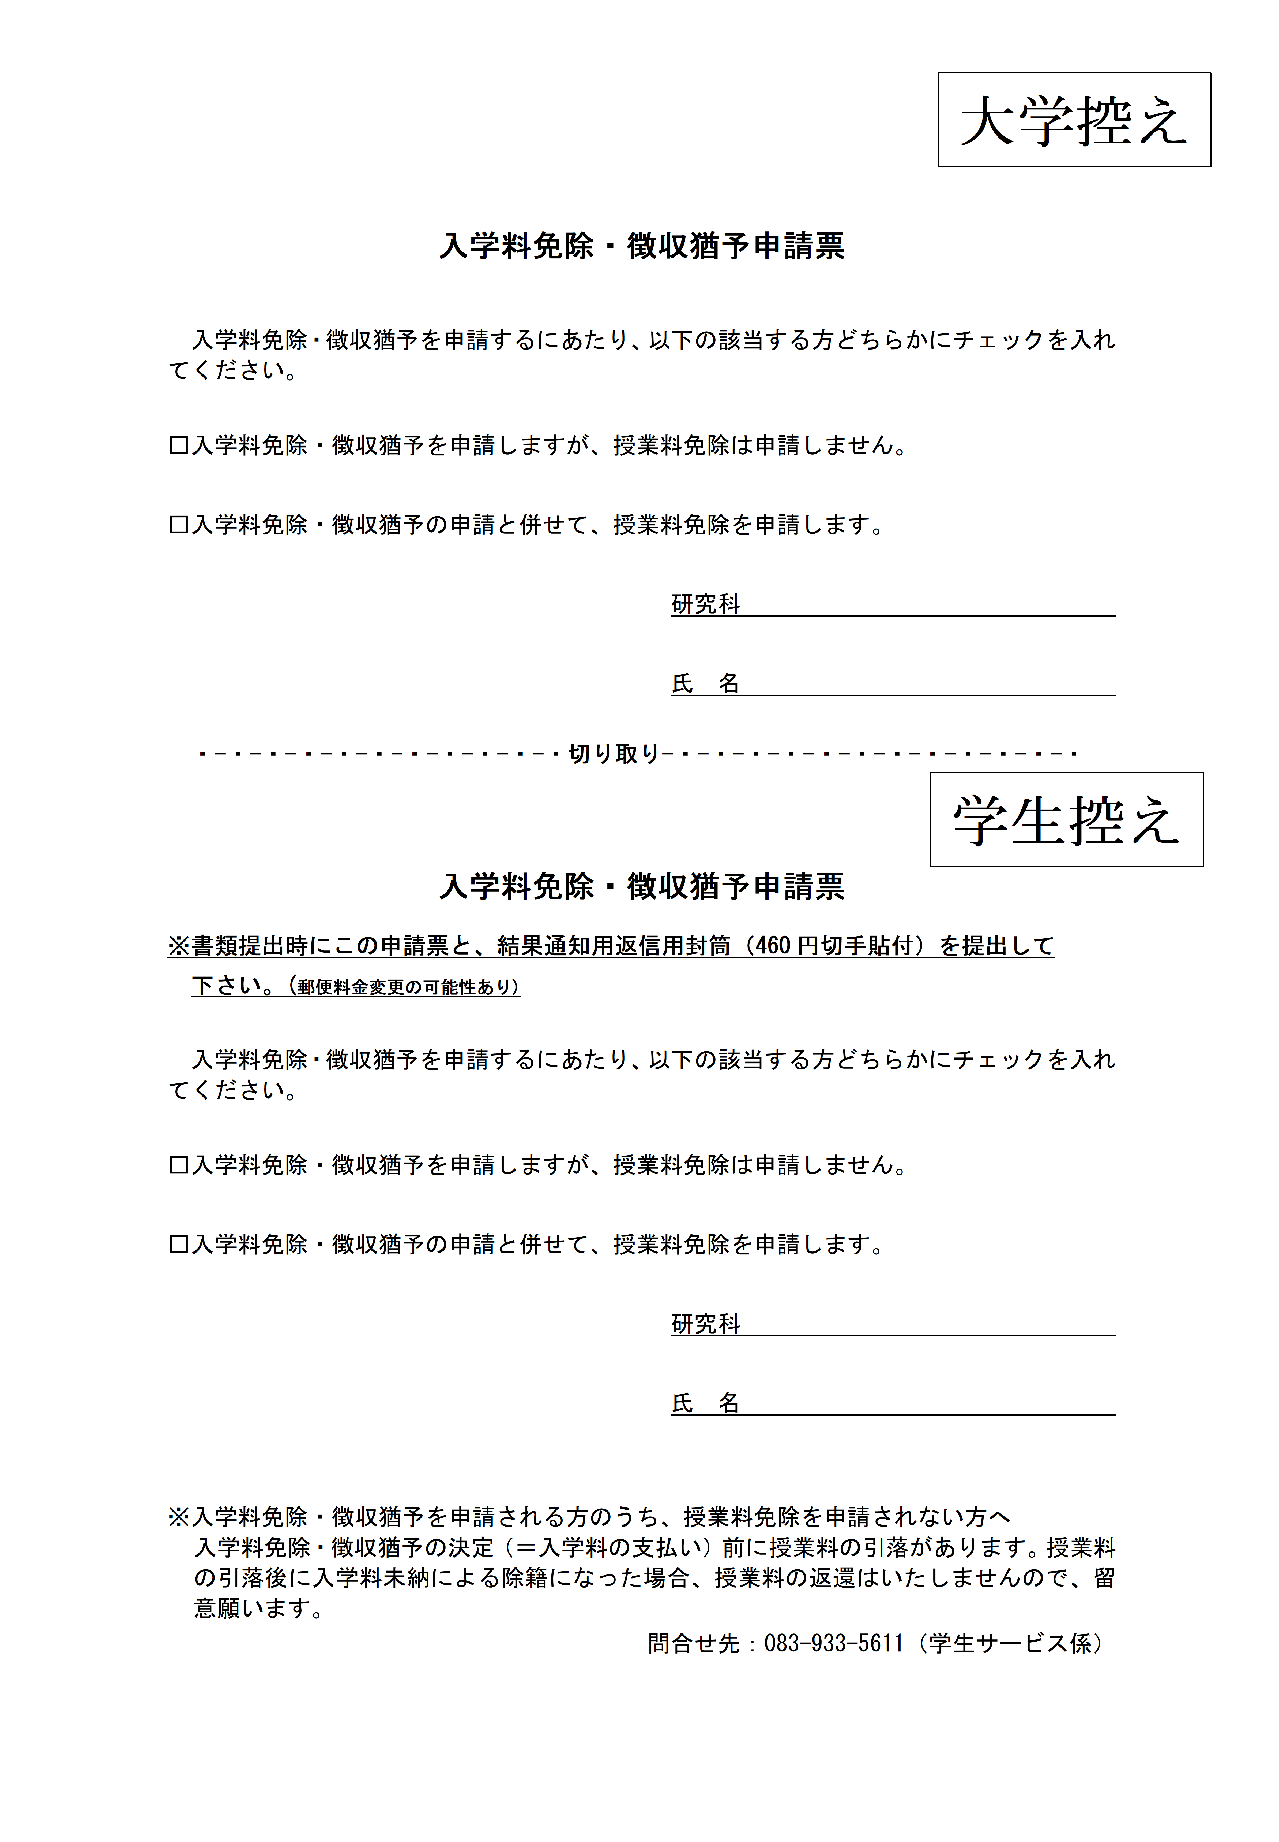
Please submit the application form together with the tuition fee waiver application form after the enrollment procedures.
Please submit the application form together with the tuition fee waiver application form after the enrollment procedures.
問合せ先：083-933-5611（経済支援係）

